Slide 1

Bots in Teams
Including
Cards,
Connectors, and
Messaging Extensions
Bob German Partner Technical Architect
One Commercial Partner
Notes:
Demo setup
Start WebDev17
Start VS 2 times – Lab bot and Cbot

Slide 2


Agenda
Bot Framework and Azure Bot Service
Activities, Messages, and Dialogs
Language Understanding with LUIS
Message Cards/Adaptive Cards
Office 365 Connectors in Teams

Slide 3

Writing a Bot for Teams
It’s just a REST service …
hosted anywhere
registered w/Azure Bot Service
referenced in Teams app manifest
Bot Builder SDK for C# or Node.js
Cognitive services LUIS, Q&A Maker
Azure Bot Service
Your Bot Web Service
Bot Builder SDK
External App Web Service
LUIS

Slide 4








Channels and Activities
Azure Bot Services
User
Channel
Bot
Channel
Channel
REST services
Activities
- Message
- Invoke (message ext.)
- Conversation Update - Typing - Delete User Data - Contact Relation Update
Messages
- Text - Rich attachments (e.g. images)
- Custom format (e.g. adaptive cards)
Notes:
Activities are more than receiving messages, and include Typing (user is typing) and ConversationUpdate (members added and removed from the conversation).
Text messages are always possible, but beyond that message formats vary by application; Bot needs to deal with that.

Slide 5
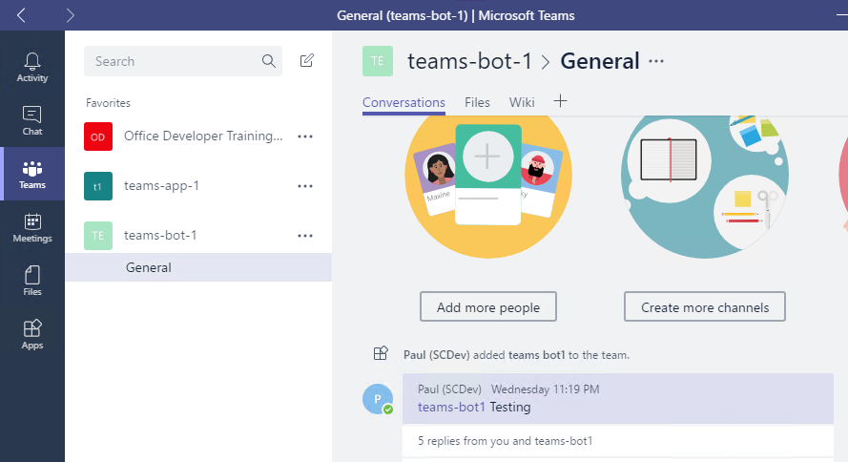
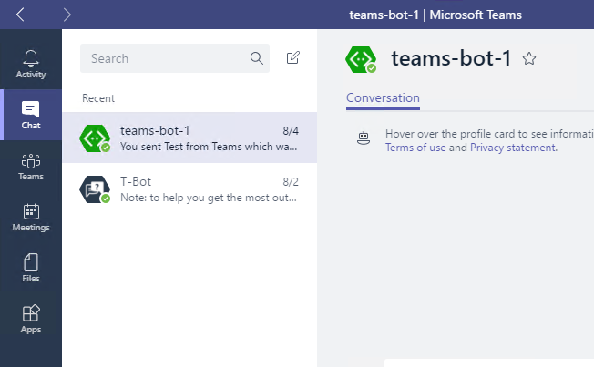
Channel conversations and 1:1 conversations
Channel conversation
Access to channel data, including members
Events when users added/removed from channel
Messages will contain ‘at’ (@) mentions of the bot <at>MyBot</at>
1:1 conversation
Access only to user – not team
Event when user initiates conversation
No ‘at’ mentions for the Bot

Slide 6
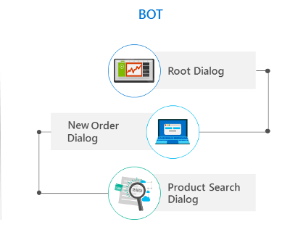
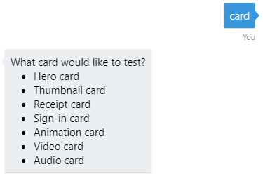
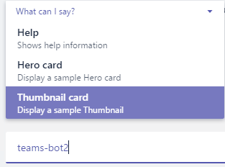
Bot Interaction
Dialogs
Allow reusing of parts of a directed conversation
Stack of dialogs – top one gets message
Call or forward an activity to a dialog
Prompt dialog
SDK-provided dialog
Declare choices in code
Top of stack until valid choice selected
Provide option to quit or limit number of attempts
Bot menu
Teams-specific implementation
Declare choices in manifest
Guides user, but can type anything
Keep it short & simple
Notes:
Scorable dialog registered as Global Handler in Application_Start
Prompt dialog called from other dialogs
Bot Menu is not in Bot code – only manifest & Teams client

Slide 7
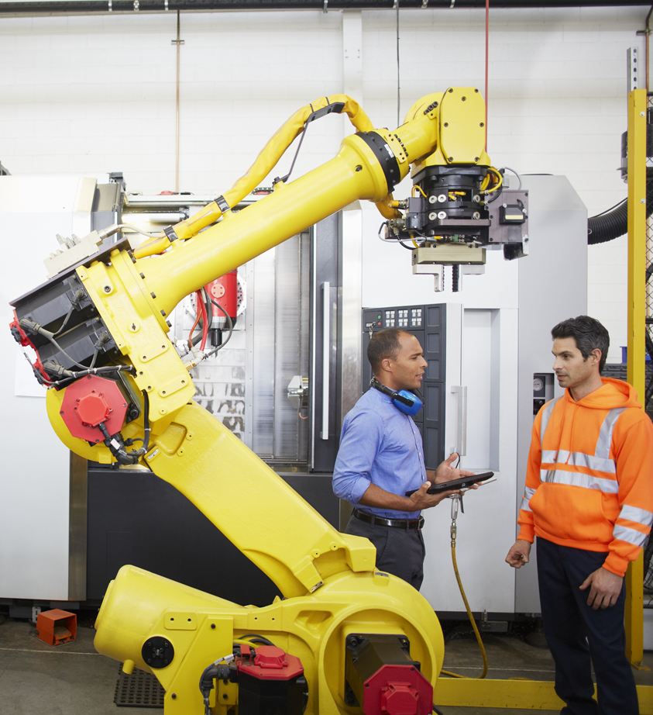
Dialogs
I’d like to order a pizza
Certainly, what kind would you like?
Anchovy and onion
Are you sure you want anchovies?
Break the conversation up into reusable pieces
Maintain state/context
Between utterances
Between dialogs in a chain
Store in memory, Azure Table storage, document DB, or custom

Slide 8
Dialog State
User Data
Private Conversation Data
Saved for a user
Saved for a user within just this conversation
Conversation Data
Saved for the whole conversation
Store state:
In memory (dev only)
Azure table storage
CosmosDB
Custom
Call DeleteStateForUser() to forget users when they leave a conversation
DialogState – like ViewState, stores serialized Dialog objects as conversation data

Slide 9
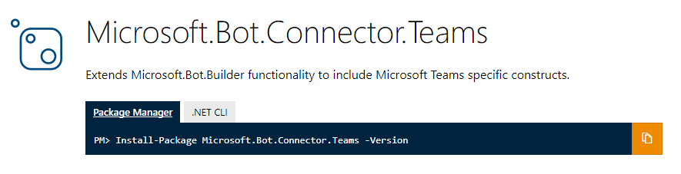
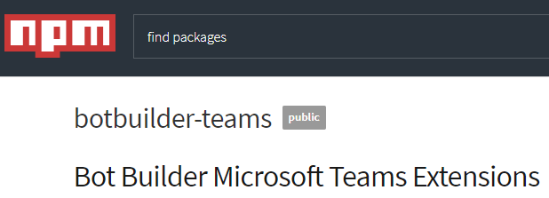
Teams-Bot-extensions
Extensions and utilities
ConnectorClient
Parse activities to system events
Parse activities to channel/member information
Extract @mentions from text
ProcessAttachments
Data models
Tenant
Team/channel
ComposeExtension
Cards
Tenant filtering
Notes:
Extension library accelerates development
Manages connection to Bot service – facilitates updats
Types to represent events
Strongly-typed data models

Slide 10
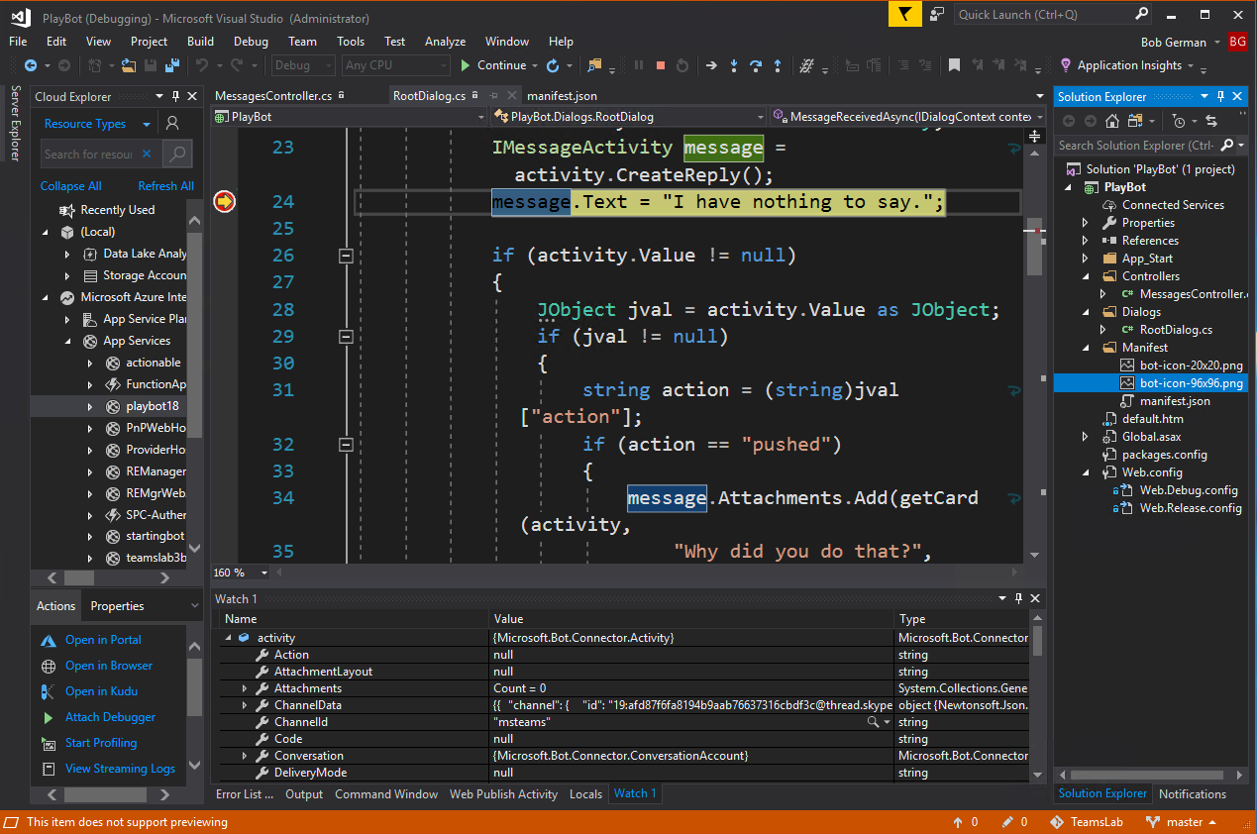
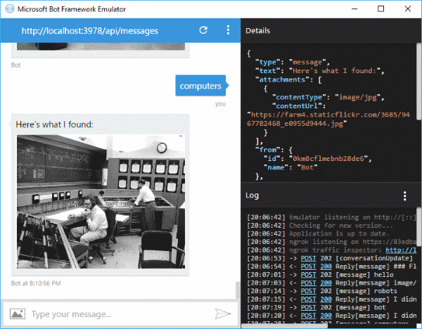
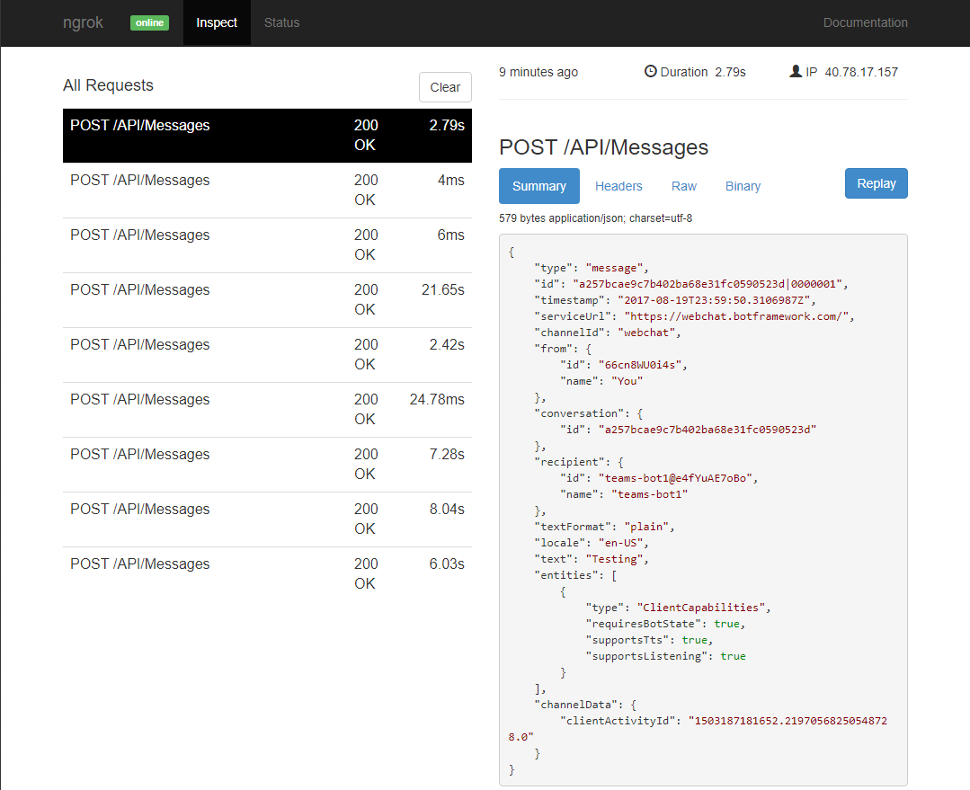
Testing your Bot
Bot Framework Emulator
Separate download
Does not require registration
Can connect to bot on localhost
Supports speech recognition
Send sample Team Member Events
ngrok Tunnel
3rd party tool tunnels internet requests to local machine
Allows inspection of request/response
Free version changes the URL every use (8 hr max)
App Service with Remote Debugger
Run directly in Azure
Attach Visual Studio debugger
Notes:
Emulator download page: https://emulator.botframework.com/

Slide 11
Bot Basics
Using ngrok
Using the Bot Framework Emulator
Messages Controller → Root Dialog → Child Dialogs
Handle system events
Bot registration and manifest
demo
Notes:
Use Cbot – start below
Type ngrok http 8080 and explain
Start ngrok and Cbot
Send some Cbot messages – “Help” and then “Card Please” Show ngrok trace http://localhost:4040
Open Bot emulator http://localhost:3978/api/messages – same queries
Demo Cbot and walk through code
- Messages controller
- RootDialogSimple
- Child dialogs
Show bot registration
Show manifest

Slide 12


Messages – Text formats
Format | From user to bot | From bot to user | Notes
Rich text |  |  | Basic markdown, no tables
Pictures |  |  | Maximum 1024×1024 and 1 MB in PNG, JPEG, or GIF format; animated GIF not officially supported
Cards |  |  | Currently supports Hero, Thumbnail, and Office 365 Connector cards
Emojis |  |  | Currently supports emojis via UTF-16 (such as U+1F600 for grinning face)

Slide 13

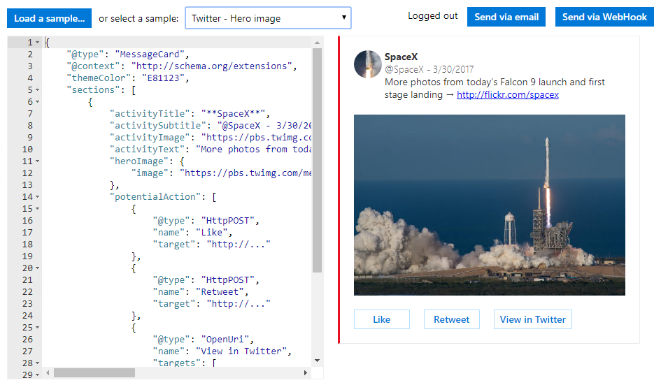
Message Cards for Outlook, Teams, and more
https://messagecardplayground.azurewebsites.net
DEMO Message Card Playground
Notes:
Use the MessageCard Playground to view samples and design your own cards
CRM Opportunity is a nice example

Slide 14
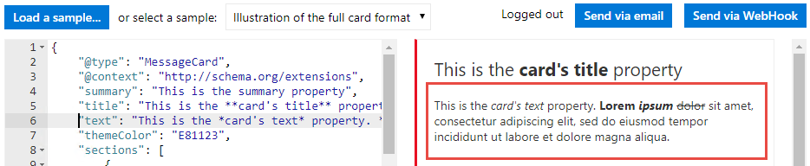
Card JSON
Card fields include title, text, summary, themeColor
Section fields include title, text, various images, potentialAction
Text formatting with basic markdown
Notes:
hideOriginalBody is useful if the card itself contains all the information a user would need or if the content of the card is redundant with the content of the body. Always include an HTML body as that is rendered for clients that do not support cards.
Don’t use hyperlinks or markdown in the title.
Can use hyperlinks or markdown in the text.

Slide 15
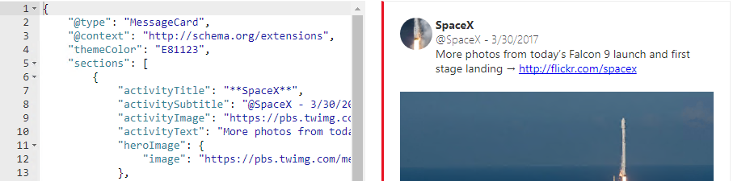
Card JSON
Card fields include title, text, summary, themeColor
Section fields include title, text, various images, potentialAction
Text formatting with basic markdown
Notes:
hideOriginalBody is useful if the card itself contains all the information a user would need or if the content of the card is redundant with the content of the body. Always include an HTML body as that is rendered for clients that do not support cards.
Don’t use hyperlinks or markdown in the title.
Can use hyperlinks or markdown in the text.

Slide 16
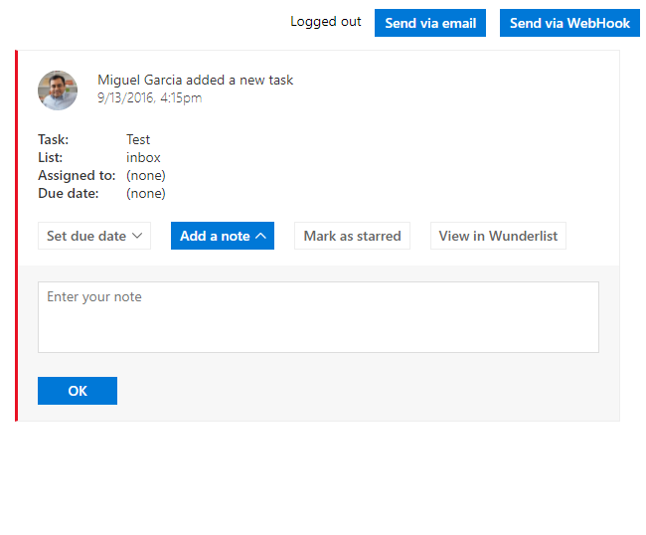
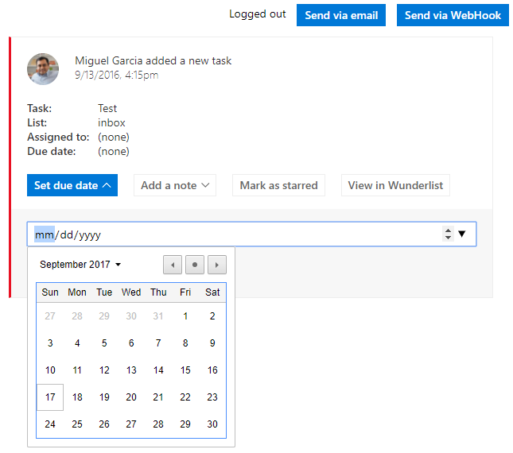
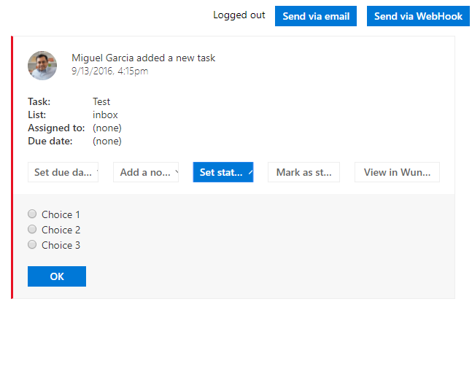
Inputs
TextInput
Use when you need users to provide text.
DateInput
Use when you need users to provide a date and/or a time.
MultichoiceInput
Use when you need users to select from a list of pre-defined choices.

Slide 17
Adaptive Cards in Bots Files in Bots
demo
Notes:
Use LAB bot
CARDS:
In Talent Management / General
@TalentBot18 schedule john smith 30030
Code walk-through:
- CardHelper.cs 264+ -- code to make the card; note the action body and action starting line 291
- CommandHandlers.cs 47- skip to 58-66 – code to send the card
- CommandHandlers.cs 21-32 – code to receive the message action
Easier to see card actions in the other demo
FILES:
In 1:1 chat – upload a TEXT file – Bot echoes it back
Code – RootDialog.cs lines 38-51
Type “resume for katie Jordan” Receive a file – download to view – it’s in OneDrive Applications/appname/
Code – RootDialog.cs lines 115-end

Slide 18
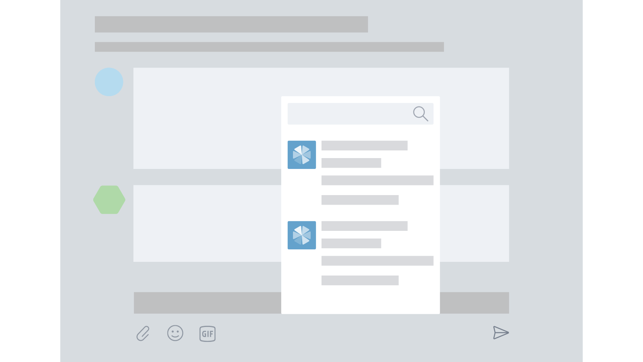
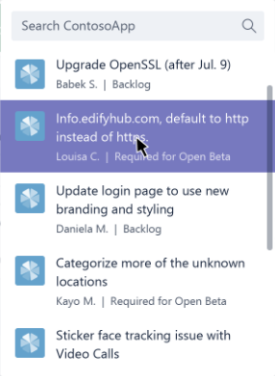
Introduction to Messaging Extensions
Look up information while composing a message in channel or chat
Users select entity from your extension/app
Card added to message
Multiple extensions can be registered for your app
Entity display is customizable
Initial display control
Automatic rendering & submission of search
You decide entities and render in cards

Slide 19
Messaging Extensions
demo
Notes:
Use Cbot
In any Trey Research channel, @CBot18 Bill 30 hours to … (pick Contoso)
Notice you can add more than one and use it anywhere in chat
Show manifest.json 54-75 – note the bot ID and parameters
MessageController.cs 23-29 – Receive invoke call from Teams
ComposeHelpers.cs 16+ - Handle the invoke call

Slide 20
LUIS: Language Understanding Intelligent Service
Turns utterances into intents and entities
“Book me a flight to Paris next Wednesday”
intent
entities

Slide 21
LUIS
demo
Notes:
Show LUIS portal … create a model and intent from the audience …
Show demo intents, entities
Show RootDialogLuis.cs

Slide 22
Determining Intent
Business Domain
Conference Management Bot
Get video
Top Business Intents
Booking Information
Agenda Information
Exhibitor Information
General Q&A
LUIS Intents
Make Booking
Get agenda
Exhibitor.
How to Apply
General Q&A
Get Booking Balance
Exhibitor.
Levels
Reset Password
Get Booking Status
Booking Refund
None
From Machine Learning, AI & Data Science conference, June 2018 – Anna Thomas and Chris Testa-O’Neill, “NLU with LUIS”

Slide 23
Understanding Entities
Entities are optional but highly recommended
Entities represent parameters or data for an intent
Entities are shared across intents
There are different types of entities
From Machine Learning, AI & Data Science conference, June 2018 – Anna Thomas and Chris Testa-O’Neill, “NLU with LUIS”

Slide 24
Entity Types
Simple
List
Hierarchical
Composite
From Machine Learning, AI & Data Science conference, June 2018 – Anna Thomas and Chris Testa-O’Neill, “NLU with LUIS”

Slide 25
Utterance Design Guidance
Begin with 10-15 utterances per intent
Collect phrases that you think users will say
Use the representative language of the user
Include utterances that mean the same but are constructed differently.
Be mindful that utterances aren't always well formed
Choose varied terminology as well as phrasing
None intent should have between 10-20 % of the total utterances.
From Machine Learning, AI & Data Science conference, June 2018 – Anna Thomas and Chris Testa-O’Neill, “NLU with LUIS”

Slide 26
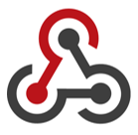
What’s a WebHook?
A WebHook is an HTTP callback POST is sent to a URL as a notification that something happened
Universal model used not just by Office 365 (e.g. WordPress, GitHub, MailChimp, etc.)
POST https://outlook.office.com/webhook/7bfe...
Teams Service
Your application
HTTP/1.1 200 OK
Applications can add messages to a Teams conversation via a webhook

Slide 27
Connectors
demo
Notes:
Run LAB BOT
Show connector config page
Demo in Postman
Show connector portal
Show manifest
Show connectorconfig.html

Slide 28
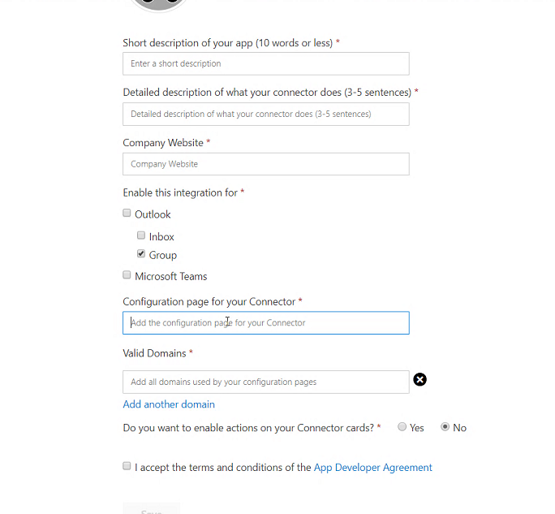
Connector Registration and Configuration
Connector Configuration page
Specified in Connector Developer Dashboard http://bit.ly/ConnectorDashboard
Hosted by developer
Must be hosted at a domain listed on dashboard
Loaded in IFRAME in application
Connector Instances
Connector can be configured for multiple Inboxes/Channels
A connector can have multiple instances for same inbox/channel
Store configuration data for each instance

Slide 29
Configuration page
Configuration Page
App-Specific Page (IFrame)
JavaScript
Include Connectors JavaScript Library
Call office365.initialize() method to display page
Save button is disabled by default
Call office365.settings.setValidityState() after validation
Register an OnSaveHandler
Store configuration data
Call office365.settings.setSettings() to persist Connector instance information
Call notifySuccess() or notifyFailure() to close dialog
JS
Connectors JS Lib
https://(URL of page in your app)
HTML
Do not include chrome
Logo and Description from dashboard are displayed by application
Include form to capture configuration data for external system
Types of events to send connector cards
Time / frequency of reports or digests
Authentication information
Etc.
https://(some O365 URL)
Notes:
Provide data in well-defined fields. Rendering is handled by host application

Slide 30

Configuration page
Captures information about your connector’s configuration
Webhook URL
Uniquely identifies the webhook that can be used to post notifications for the given configuration only
You’ll need this information to send messages to Teams. Store it securely!
Email Address
The address of the user (Outlook Inbox) or O365 group mailbox
Channel Id
Id of the channel where connector is configured in Microsoft Teams.
Notes:
Provide data in well-defined fields. Rendering is handled by host application

Slide 31

Security Requirements
Use HTTPS
Page must use HTTPS
Applications will not display insecure HTTP content
Secure the webhook URL
Webhook URL is passed as query parameter
Can be disclosed if Configuration page has links to other websites; If it does, implement a redirect or referrer policy on the page:
Once data is stored, redirect browser to page w/o query parameters (HTTP 302)
Add <meta> tag to page header
<meta name="referrer“ content="no-referrer">

Slide 32

Resources
Teams App Design guidance http://bit.ly/Design4Teams
Teams App Studio https://aka.ms/InstallTeamsAppStudio
Bot Builder Quickstart http://bit.ly/AzBotBuilder
LUIS (natural language for Bots) https://www.luis.ai/
Bot Graph Explorer http://bit.ly/Bot4Graph
Bot Excel Demo http://bit.ly/Bot4Excel

Slide 33
Thank you!
Bob German Partner Technical Architect
One Commercial Partner

